Slide 1
Uva 11456 Transorting
Times: 1 second

Slide 2
Problem Descriptions (1/3)
Erin is an engineer. She drives trains. She also arranges the cars within each train.
She prefers to put the cars in decreasing order of weight, with the heaviest car at the front of the train.
Unfortunately, sorting train cars is not easy. One cannot simply pick up a car and place it somewhere else.

Slide 3
Problem Descriptions (2/3)
It is impractical to insert a car within an existing train. A car may only be added to the beginning and end of the train.
Cars arrive at the train station in a predetermined order. When each car arrives, Erin can add it to the beginning or end of her train, or refuse to add it at all.

Slide 4
Problem Descriptions (3/3)
The resulting train should be as long as possible, but the cars within it must be ordered by weight.
Given the weights of the cars in the order in which they arrive, what is the longest train that Erin can make?

Slide 5
Input
The first line is the number of test cases to follow.
The test cases follow, one after another; the format of each test case is the following:
The first line contains an integer 0≤n ≤2000, the number of cars.
Each of the following n lines contains a non-negative integer giving the weight of a car.
No two cars have the same weight.

Slide 6
Output
Output a single integer giving the number of cars in the longest train that can be made with the given restrictions.

Slide 7

I/O Example
Input
1
3
1
2
3
Number of test case
Output
3
Number of cars
Weights of cars

Slide 8
Solution
LIS
m_{大}
m_{小}
比 M 小
M
M_{小}
M_{大}
比 M 大
LDS
m_{大}
m_{小}
M
M_{大}
M_{小}
大
小

Slide 9
Example
LIS
6 5 4 3 1
比 M 小
6
6 7 8 9
比 M 大
LDS
6 7 5 8 9 4 3 1
m_{大}
m_{小}
9
8
7
6
5
4
3
1
M_{大}
M_{小}

Slide 10
Example
1 | 2 | 3
1 | 1 | 1 | LIS
3 | 2 | 1 | LDS
3 | 2 | 1 | LIS+LDS-1
3 2 1
3 | 1 | 2
2 | 1 | 1 | LIS
1 | 2 | 1 | LDS
2 | 2 | 1 | LIS+LDS-1
3 1
3 2
2 1

Slide 11
Longest Increasing Subsequence
Problem a sequence {x[0], x[1],…,x[n-1]}, determine its Longest Increasing Subsequence.
Example: n=8
X = {9, 5, 2, 8, 7, 3, 1, 6,4}
LIS is {2, 3, 6} or {2,3,4}, lenngth=3.

Slide 12
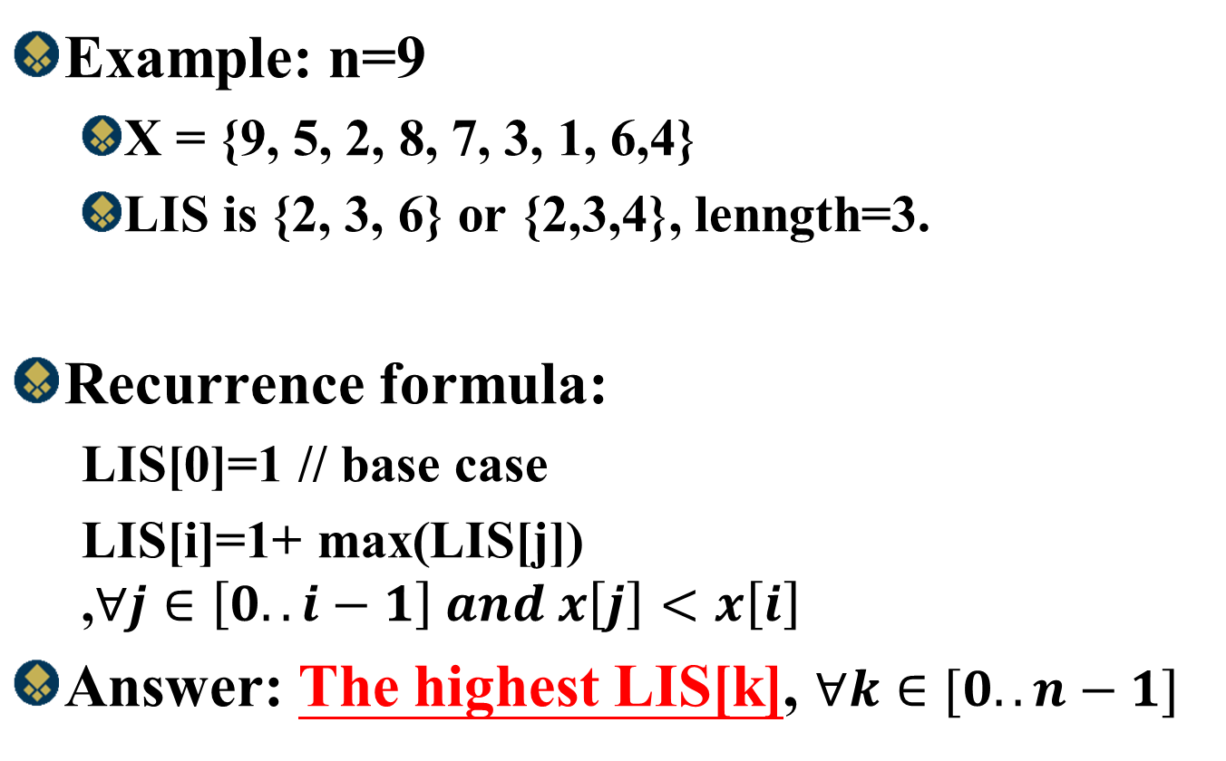
Longest Increasing Subsequence
Example: n=9
X = {9, 5, 2, 8, 7, 3, 1, 6,4}
LIS is {2, 3, 6} or {2,3,4}, lenngth=3.
Recurrence formula:
LIS[0]=1 // base case
LIS[i]=1+ max(LIS[j]) ,$∀j∈\left[0..i−1\right] and x\left[j\right]<x\left[i\right]$
Answer: The highest LIS[k], $∀k∈[0..n−1]$

Slide 13
Example
Example: n=9
X = {9, 5, 2, 8, 7, 3, 1, 6,4}
Length=3
index | 0 | 1 | 2 | 3 | 4 | 5 | 6 | 7 | 8
X | 9 | 5 | 2 | 8 | 7 | 3 | 1 | 6 | 4
LIS[0] | 1
LIS[1] | 1 | 1
LIS[2] | 1 | 1 | 1
LIS[3] | 1 | 1 | 1 | 2
LIS[4] | 1 | 1 | 1 | 2 | 2
LIS[5] | 1 | 1 | 1 | 2 | 2 | 2
LIS[6] | 1 | 1 | 1 | 2 | 2 | 2 | 1
LIS[7] | 1 | 1 | 1 | 2 | 2 | 2 | 1 | 3
LIS[8] | 1 | 1 | 1 | 2 | 2 | 2 | 1 | 3 | 3
Final | 1 | 2 | 2 | 2 | 2 | 1 | 1 | 3 | 3

Slide 14
Example
Example: n=9
X = {9, 5, 2, 8, 7, 3, 1, 6,4}
Length=3
index | 0 | 1 | 2 | 3 | 4 | 5 | 6 | 7 | 8
X | 9 | 5 | 2 | 8 | 7 | 3 | 1 | 6 | 4
LIS[0] | 1
LIS[1] | 1 | 1
LIS[2] | 1 | 1 | 1
LIS[3] | 1 | 1 | 1 | 2
LIS[4] | 1 | 1 | 1 | 2 | 2
LIS[5] | 1 | 1 | 1 | 2 | 2 | 2
LIS[6] | 1 | 1 | 1 | 2 | 2 | 2 | 1
LIS[7] | 1 | 1 | 1 | 2 | 2 | 2 | 1 | 3
LIS[8] | 1 | 1 | 1 | 2 | 2 | 2 | 1 | 3 | 3
Final | 1 | 2 | 2 | 2 | 2 | 1 | 1 | 3 | 3

Slide 15
Example
Example: n=9
X = {9, 5, 2, 8, 7, 3, 1, 6,4}
Length=3
index | 0 | 1 | 2 | 3 | 4 | 5 | 6 | 7 | 8
X | 9 | 5 | 2 | 8 | 7 | 3 | 1 | 6 | 4
LIS[0] | 1
LIS[1] | 1 | 1
LIS[2] | 1 | 1 | 1
LIS[3] | 1 | 1 | 1 | 2
LIS[4] | 1 | 1 | 1 | 2 | 2
LIS[5] | 1 | 1 | 1 | 2 | 2 | 2
LIS[6] | 1 | 1 | 1 | 2 | 2 | 2 | 1
LIS[7] | 1 | 1 | 1 | 2 | 2 | 2 | 1 | 3
LIS[8] | 1 | 1 | 1 | 2 | 2 | 2 | 1 | 3 | 3
Final | 1 | 2 | 2 | 2 | 2 | 1 | 1 | 3 | 3

Slide 16

Time Complexityy
Recurrence formula:
LIS[0]=1 // base case
LIS[i]=1+ max(LIS[j]) ,$∀j∈\left[0..i−1\right] and x\left[j\right]<x\left[i\right]$
Answer: The highest LIS[k], $∀k∈[0..n−1]$
O(n²)
O(n)
Find Length:O(n)+O(n²)=O(n²)
Find LIS subsequence: O(n)

Slide 17
Example
Example: n=9
X = {9, 5, 2, 8, 7, 3, 1, 6,4}
Length=3
index | 0 | 1 | 2 | 3 | 4 | 5 | 6 | 7 | 8
X | 9 | 5 | 2 | 8 | 7 | 3 | 1 | 6 | 4
LIS[0] | 1
LIS[1] | 1 | 1
LIS[2] | 1 | 1 | 1
LIS[3] | 1 | 1 | 1 | 2
LIS[4] | 1 | 1 | 1 | 2 | 2
LIS[5] | 1 | 1 | 1 | 2 | 2 | 2
LIS[6] | 1 | 1 | 1 | 2 | 2 | 2 | 1
LIS[7] | 1 | 1 | 1 | 2 | 2 | 2 | 1 | 3
LIS[8] | 1 | 1 | 1 | 2 | 2 | 2 | 1 | 3 | 3
Final | 1 | 2 | 2 | 2 | 2 | 1 | 1 | 3 | 3
{9(1)}
{5(1)}
{2(1)}
{2(1), 8(2)}
{2(1), 7(2)}
{2(1), 3(2)}
{1(1), 3(2)}
{1(1), 3(2),6(3)}
{1(1), 3(2),4(3)}

Slide 18
Time Complexityy
K is the length of LIS
Recurrence formula:
LIS[0]=1 // base case
LIS[i]=1+ max(LIS[j]) ,$∀j∈\left[0..i−1\right] and x\left[j\right]<x\left[i\right]$
Answer: The highest LIS[k], $∀k∈[0..n−1]$
O(nlogk)
O(n)
Find Length:O(n)+O(nlogk)=O(nlogk)
Find LIS subsequence: O(n)

